Slide 1

AWS Cloud Virtual Internship
by
Bhavana N
214G1A3207
Department of Computer Science and Engineering (Data Science)
Srinivasa Ramanujan Institute of Technology
(Affiliated to JNTUA & Approved by AICTE) (Accredited by NAAC with ‘A’ Grade & Accredited by NBA (EEE, ECE & CSE)
Rotarypuram Village, B K Samudram Mandal, Ananthapuramu – 515701.
2023 - 2024

Slide 2

Contents
Course Objective
Introduction
Technology
Applications
Modules
Real Time applications
Learning outcomes
GitHub Link
Queries

Slide 3
Course Objective
This course aims to introduce students to AWS Cloud technologies. Participants will gain practical skills for deploying applications in the AWS environment. It prepares them for real-world challenges in cloud computing.
Describe security and compliance measures of the AWS Cloud including AWS Identity and Access Management (IAM).
Create an AWS Virtual Private Cloud (Amazon VPC).
Demonstrate when to use Amazon Elastic Compute Cloud (EC2), AWS Lambda and AWS Elastic Beanstalk.
Differentiate between Amazon S3, Amazon EBS, Amazon EFS and Amazon S3 Glacier.
Demonstrate when to use AWS Database services including Amazon Relational Database Service (RDS), Amazon DynamoDB, Amazon Redshift, and Amazon Aurora.
Explain AWS Cloud architectural principles.
Explore key concepts related to Elastic Load Balancing (ELB), Amazon CloudWatch, and Auto Scaling.

Slide 4
Introduction
AWS Cloud is a leading platform that provides on-demand cloud services. It supports startups to large enterprises with various computing resources. Participants will explore cloud fundamentals and its significance in today's digital world.
Cloud Computing Fundamentals
Definition:
Cloud computing delivers computing resources over the internet.
Benefits:
Flexibility, cost efficiency, and scalability are key advantages.
Types:
Public, private, and hybrid clouds serve different organizational needs.

Slide 5
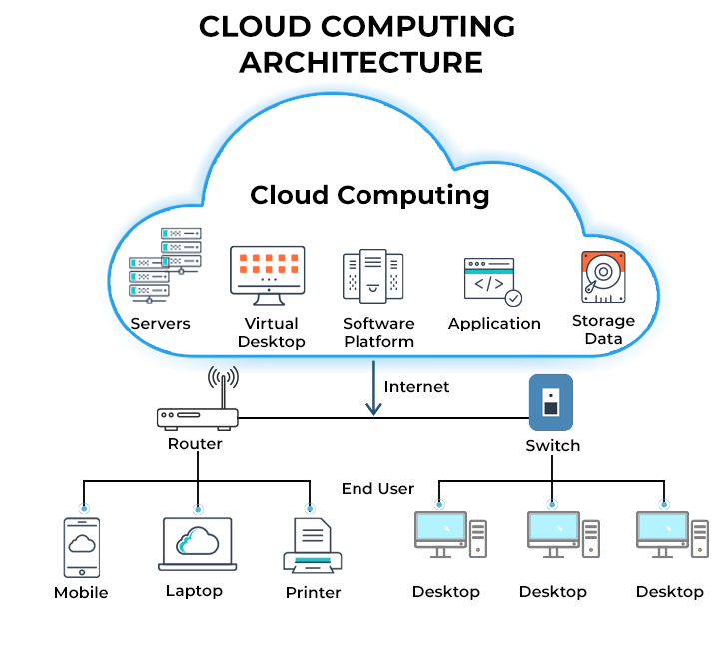
Technologies
Amazon S3(Simple Storage Service)
Amazon RDS(Relational Database Service
Amazon Aurora
Amazon DynamoDB

Slide 6
Modules
AWS Cloud Security
Networking and Content Delivery
Storage
Databases
Cloud Architecture

Slide 7
Real Time Use Case
Analytics
AWS enables real-time data analytics using services like Kinesis.
Serverless Applications
Lambda allows developers to build applications without managing servers.
Disaster Recovery
Leverage AWS for reliable backup and recovery solutions.

Slide 8
Real Time Application
Disaster Recovery and Backup
Real-Time Application: Ensuring business continuity through automated backup and disaster recovery solutions.
AWS Services: AWS Backup, Amazon RDS, Amazon S3, AWS Snowball.
Use Case: Setting up automated backups of databases and critical data to S3, with recovery mechanisms using RDS and other services.

Slide 9
Learning Outcomes
Able to explore the cloud industry and build real-world skills and connections.
Gain practical experience in AWS technologies and services.
Understand the fundamentals of AWS cloud and Infrastructure.
Understand the key Services of AWS.
Understand the Security and Compliance and the Shared Security Model.

Slide 10
Any Queries?

Slide 11
Thank You!!!

